Slide 1

MASSIVE HOTEL CENTRAL REPOSITORY
Created by Shivakaran Puramachety Date : 2023-12-01

Slide 2
Architecture Overview
Data Sources
ETL
Presentation Layer
1
6
Gold
Layer
Azure Data Factory
BI Tools
2
3
4
5
Azure
Data Lake
7
Snowflake
Reporting Tools
Bronze
Layer
Silver
Layer
Business Apps
Snowflake
Snowflake

Slide 3
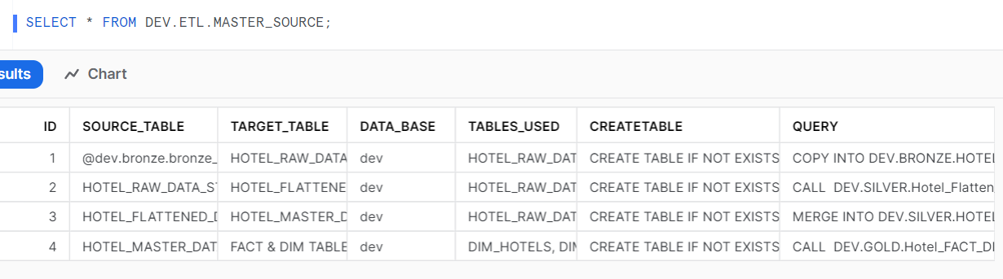
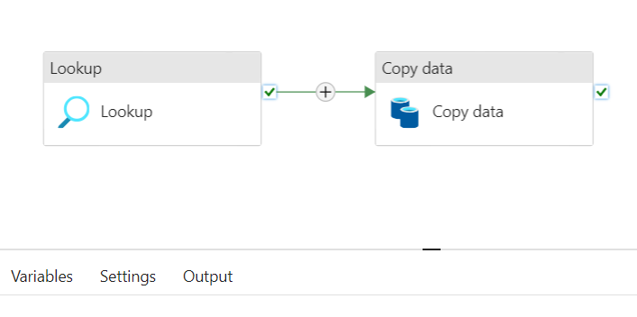
Dynamic Warehouse?. How it works?
Snowflake - ETL
Azure Data Factory (Sample Flow)
Backend Logic:
This logic is entirely dynamic and can be controlled from snowflake
There will be only single pipeline per identical data sources
Snowflake has an ETL Master Source table which consists of key ETL parameters such as database name, target table, source table, query for pulling Data, create table statements if the table doesn’t exist.
These parameters will be pulled by using lookup activity and will be further used by copy data activity to push data from source to sink in ADF.
Through this architecture, we will take care of new tables from the data source using ETL Master table without opening ADF

Slide 4
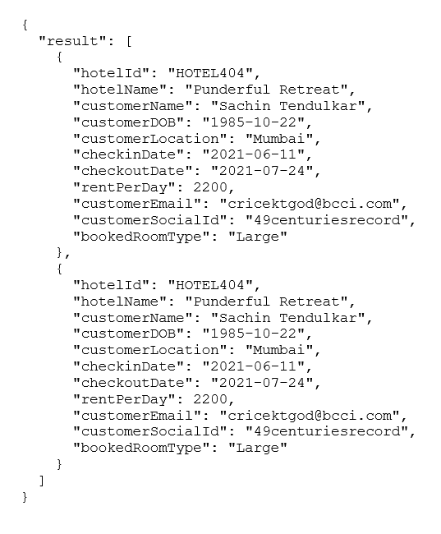
Data lake to Bronze Layer
Data Lake/container/bronze/raw
Snowflake - Bronze
Data Lake
Silver
Stream
Raw Table
Raw Table:
HotelId (type: Varchar) : Id of the hotel
hotelData (type Variant) : Holds Json data from blob.
created_date (type Datetime) : current datetime when row got created in the table.

Slide 5
Bronze to Silver
Snowflake - Silver
Master Table
Snowflake - Bronze
Snowflake - Silver
Master Table:
This will be a incremental load from Stage table with HotelId + CustomerSocialId + CheckInDate + RoomType as a primary Key.
Stream
Stage Table
Raw Table
Snowflake - ETL
Stage Table:
Columns will be created dynamically from the Json input with desired column data type.
Failed Records
Raw Table:
HotelId (type: Varchar) : Id of the hotel
hotelData (type Variant) : Holds Json data from blob.
created_date (type Datetime) : current datetime when row got created in the table.
Failed Records:
This table will be filled with Blob filename, Json data, Created date when pipeline failed to transfer data from Stage to Master.

Slide 6
Silver to Gold
Snowflake - Silver
Master Table
Snowflake - Gold
Fact Hotel Revenue
Dim Customers
Dim Hotels

Slide 7
Access Management
Account Admin
Security Admin
Sys Admin
User Admin
Data Engineer
BI Analyst Global
BI Analyst
Data Analyst
Data Engineer: Responsible for all the ETL Operations and Row/Column Access policies, this role has Read and Write
to entire database.
BI Analyst Global: Business head of the central repository, this role has read access to gold schema.
BI Analyst: Business head of a particular hotel, this role has read access gold schema (can only view filtered data at
Hotel level).
Data Analyst: Analyst of a particular hotel, this role has read access to gold schema (can only view filter data at hotel
Level and sensitive columns will be masked)

Slide 8
Notifications & ETL Logs
ETL Logs: Entire architecture is based event based trigger, whenever ADF pipeline gets triggered, It updates the ETL
Pipeline audits table present in ETL schema. Data such as, Pipeline name, Trigger Type, Run ID, Start Time, End Time,
Status, Comments (error message if pipeline failed) will be stored in the Pipeline Audits Table.
Notifications: Whenever pipeline gets runs, notification integration users will get success/fail mail with file name,
Errors if any, and status in the email body.
Project Details
Snowflake Warehouse Link: Snowflake Web UI
Dummy Users:
Username: globalaccount@massiverocket.com, Password: “Welcome@123”, Role: BI_ANALYST_GLOBAL, HotelID: Global
Username: hotelaccount1@massiverocket.com, Password: “Welcome@123”, Role: BI_ANALYST, HotelID: HOTEL401
Username: hotelaccount2@massiverocket.com, Password: “Welcome@123”, Role: BI_ANALYST, HotelID: HOTEL404
Username: hotelaccount3@massiverocket.com, Password: “Welcome@123”, Role: DATA_ANALYST, HotelID: HOTEL403
Username: hotelaccount4@massiverocket.com, Password: “Welcome@123”, Role: DATA_ANALYST, HotelID: HOTEL401
Shared Workspace link: Shared Snowflake Web UI
Username: MASSIVE_HOTEL_ADMIN, Password: “MassiveRocket123”

